Slide 1

NGO-ISAC
Assets Inventory Development
https://www.ngoisac.org/ membership@ngoisac.org

Slide 2
Assets Inventory Development (knowing what you have)
Know What You Protect
Up To Date
Inventory
Persons
Devices
Locations
Inform your Configuration Strategy

Slide 3
Definitions
Assets – A thing, device, person, or location that provides value to an organization
Device – Computer, phone, smart speaker, or possession that is used by a teammate or the organization
License – a permit to use software, device, or service that used by a teammate or the organization
People – staff, volunteers, principals, surrogates that function within the organization
Services – Products by companies outside the organization

Slide 4
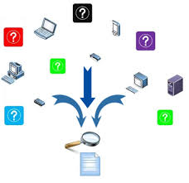
Asset Management Tooling
Asset database
Spreadsheet- example from Rip Rap Security
Specialized Tools
Snipe-IT (free open source self-hosted tool)
Asset Panda (hosted service)
Lansweeper (on prem and hosted for mature orgs)
SevCo (more mature hosted service)
Axonius (much more mature hosted service)

Slide 5
Examples
Personnel
Employees, Surrogates, Volunteers, Contractors
Devices
Laptops, Desktops, Servers, Printers, Phones, Accessories, personal devices that connect to organization services
Software and Licenses
Operating system, Office productivity, Creative productivity, Developer Tools
Services
Cloud Hosted Services, DNS, Web Hosting, SSL certificates, Office Cleaning/Trash
Notes:
While in modern computing the lines blur …
Software – things you install on your computer
Services – things you access via a webbrowser
What things are you gonna collect on each service:
Date acquired/purchased
Expiration date/renewal
Cost
SKU
Warranty information
Purchase order #
Who has possession
Latest software version

Slide 6
Asset Collection Cycle
Personnel
1
Gather Asset Information
personnel
devices
software licenses
services
4
2
Services
Devices
3
Software

Slide 7
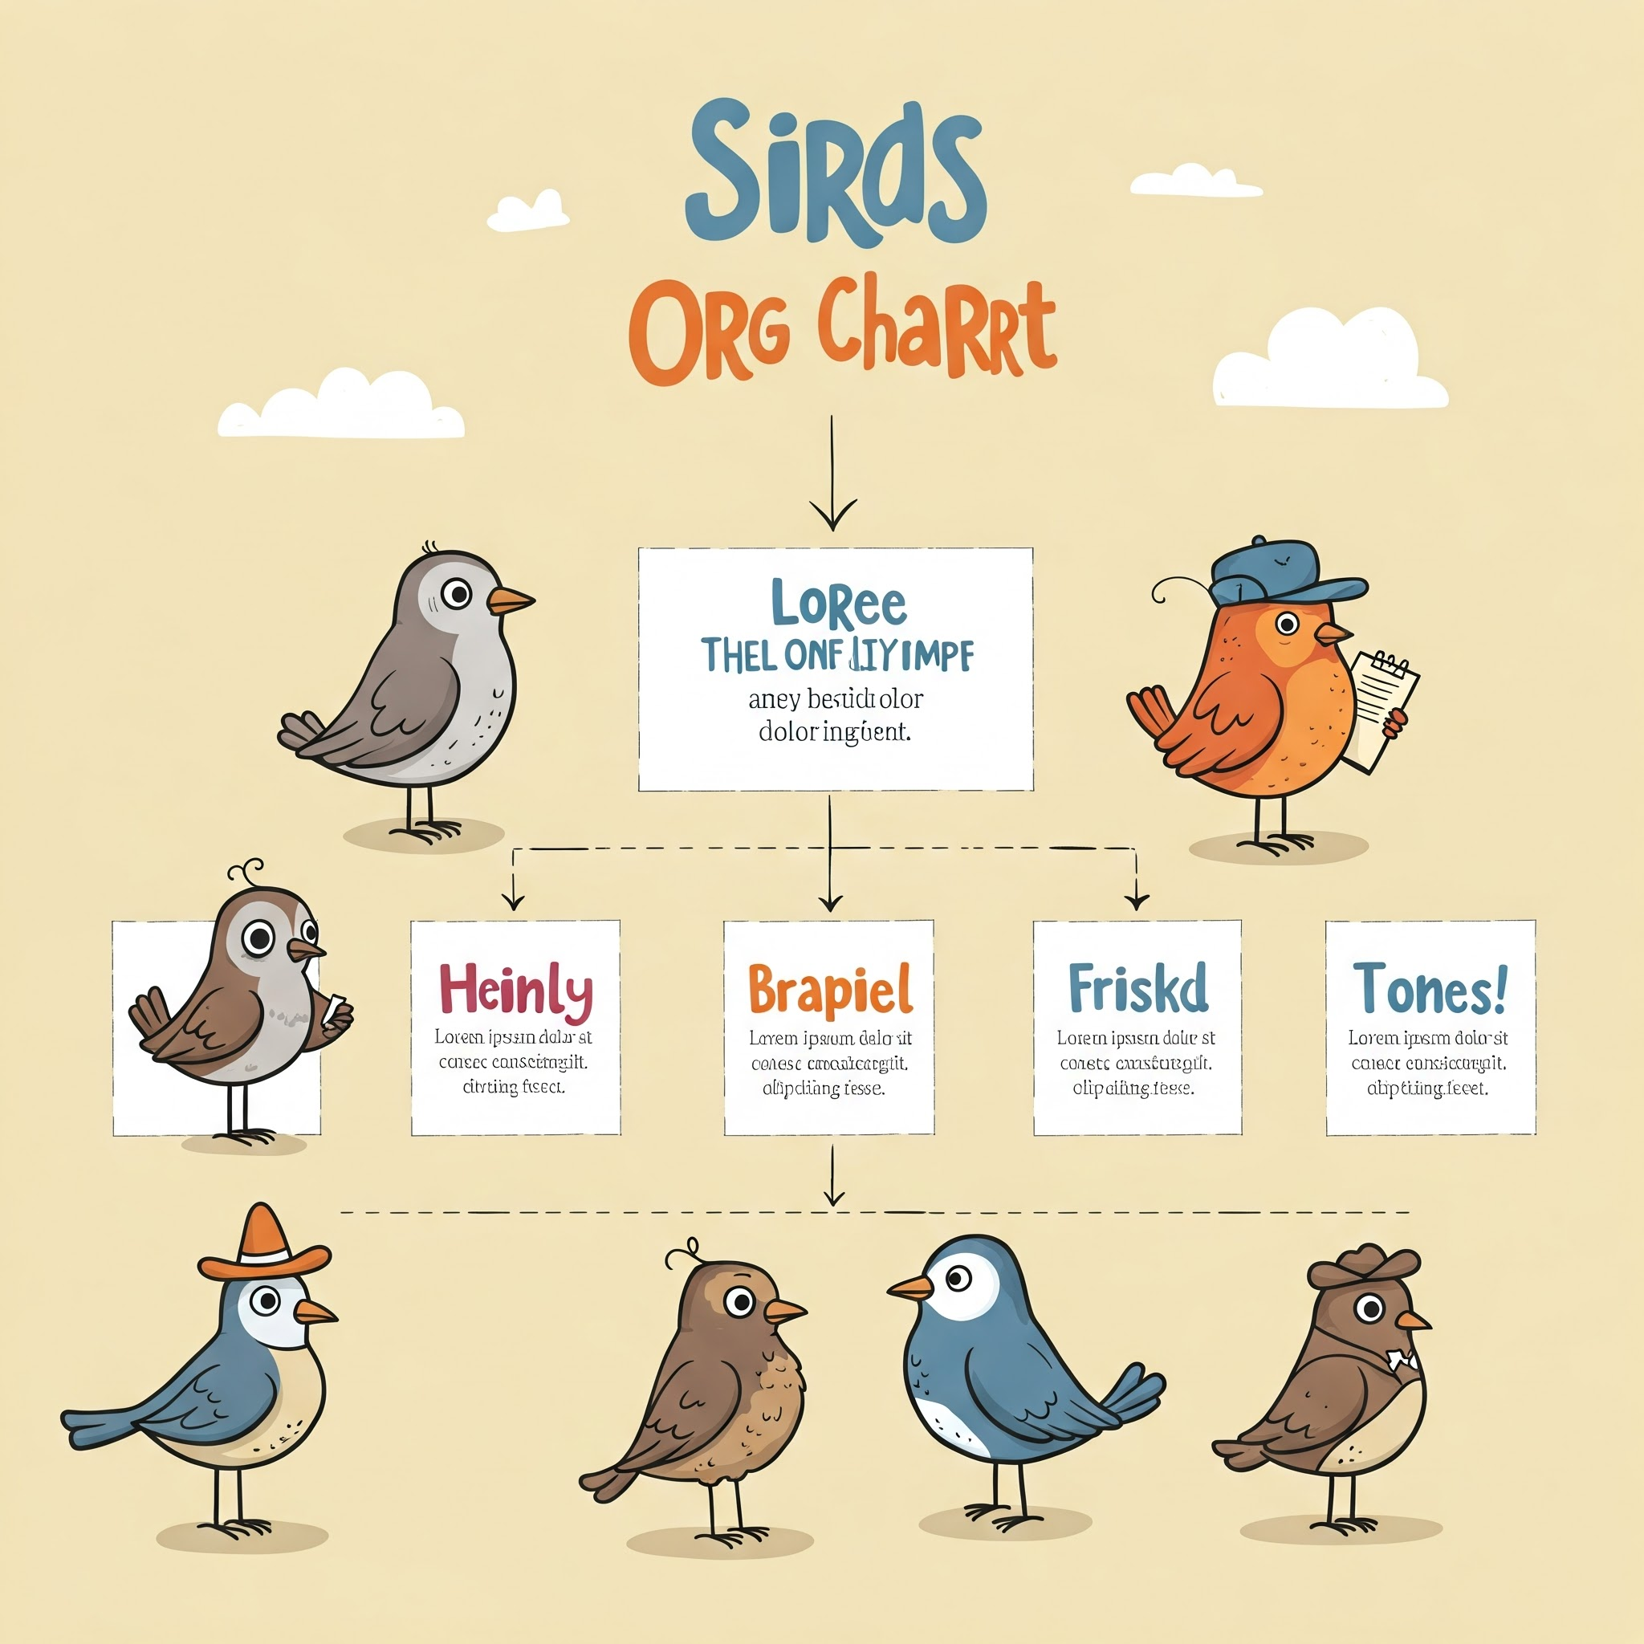
Personnel
Employees
Volunteers
Contractors
Legal
Financial
Proxies
Update the org chart.
Notes:
While in modern computing the lines blur …
Software – things you install on your computer
Services – things you access via a webbrowser
What things are you gonna collect on each service:
Date acquired/purchased
Expiration date/renewal
Cost
SKU
Warranty information
Purchase order #
Who has possession
Latest software version

Slide 8

Devices
Laptops
Desktops
Servers
Printers
Phones
Accessories,
A/V hardware
Network devices (firewall, router, …)
Personal devices
Devices that begin with smart or i
Identify retirement candidates.
Notes:
While in modern computing the lines blur …
Software – things you install on your computer
Services – things you access via a webbrowser
What things are you gonna collect on each service:
Date acquired/purchased
Expiration date/renewal
Cost
SKU
Warranty information
Purchase order #
Who has possession
Latest software version

Slide 9
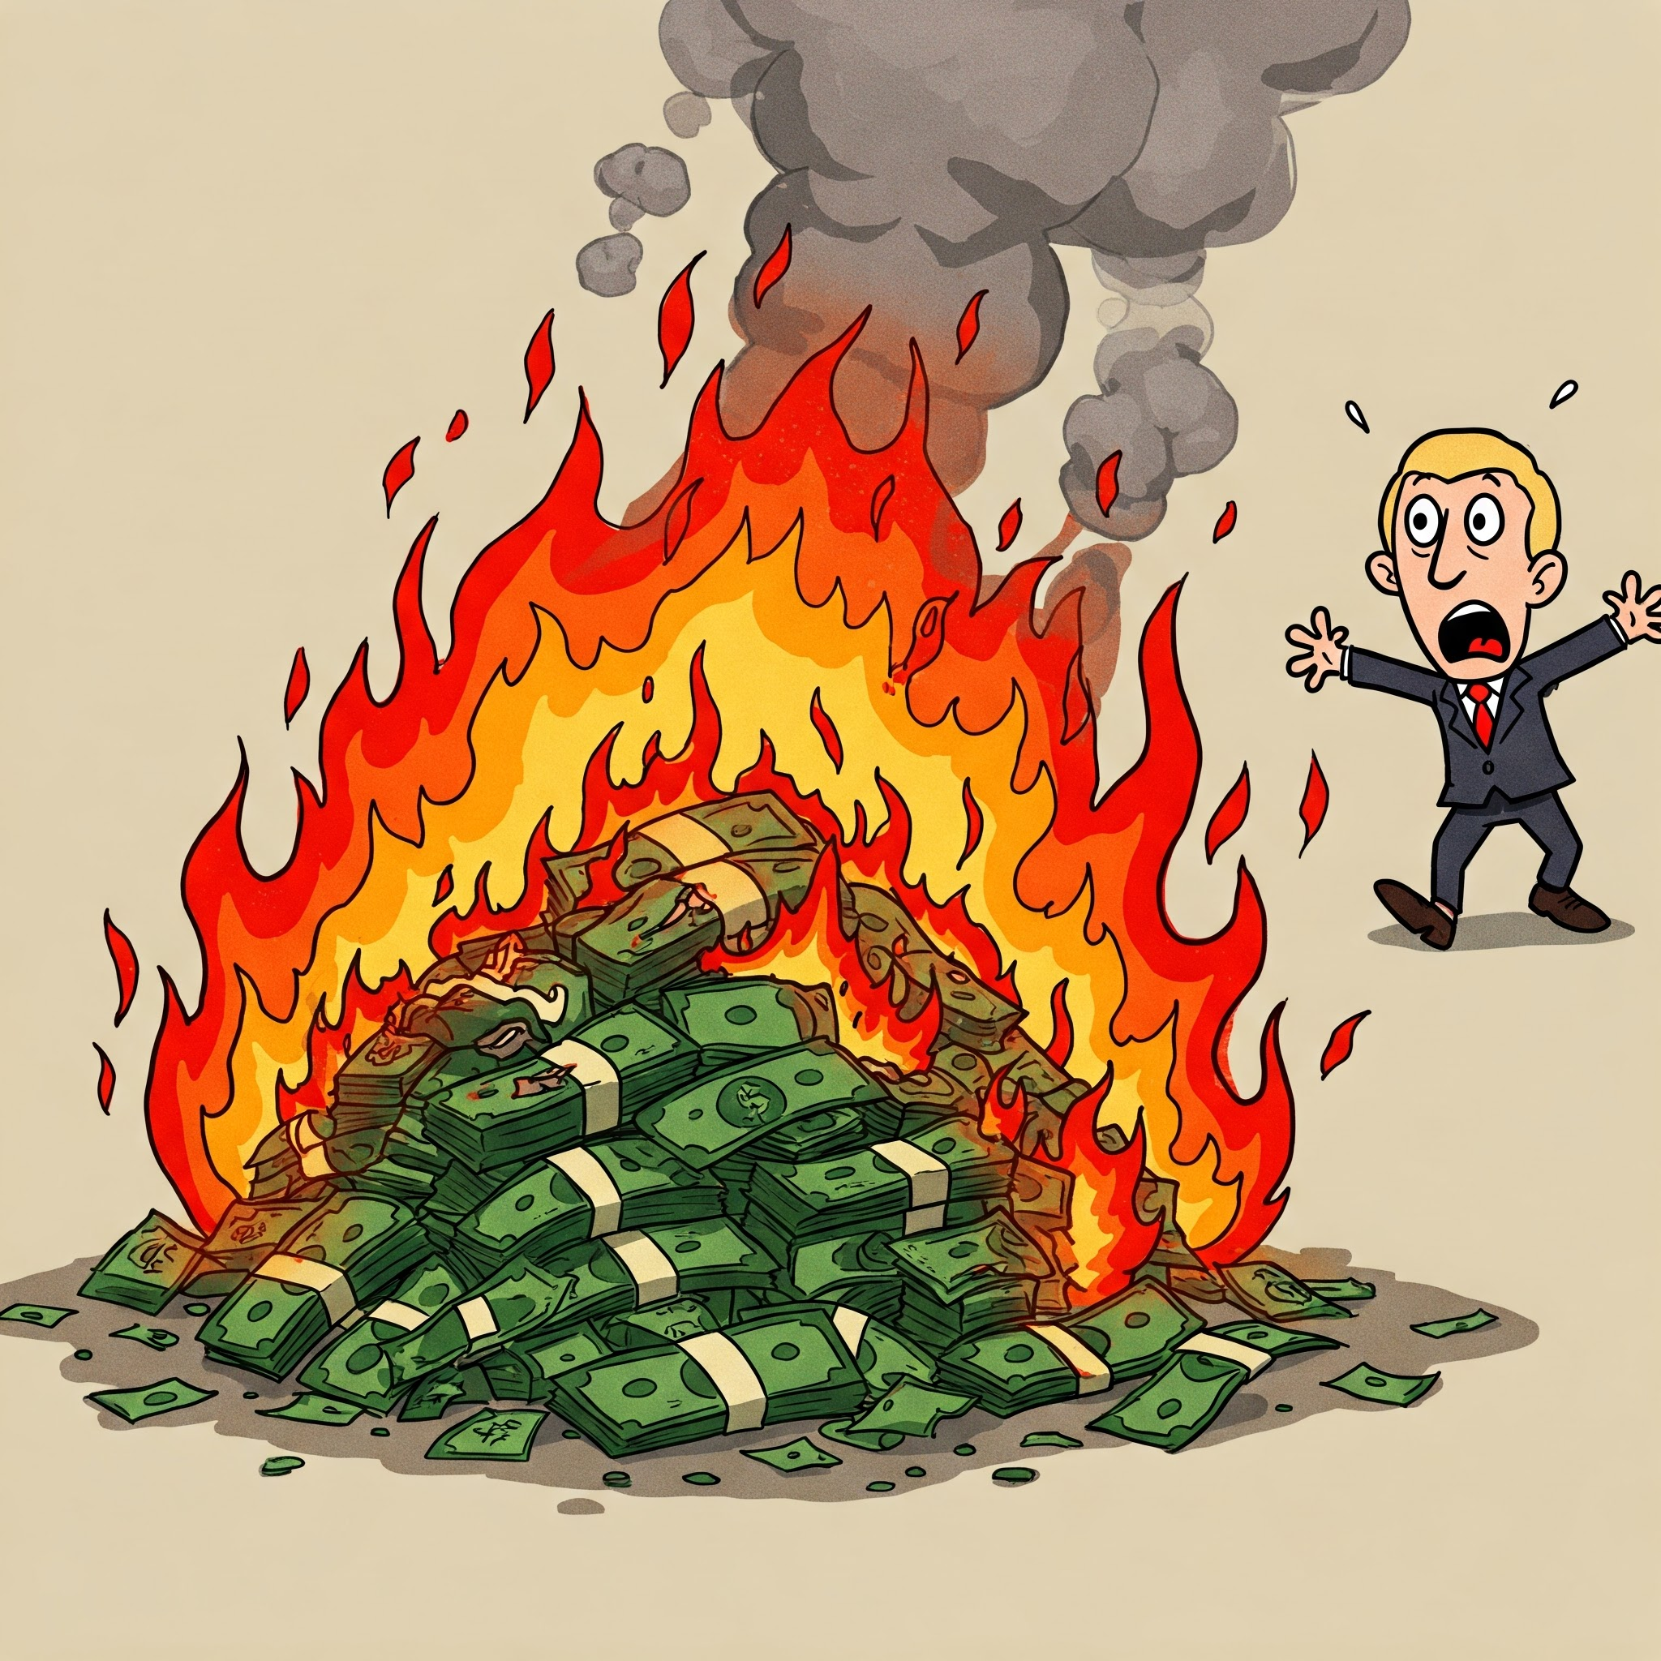
Licenses & Software
Licence key numbers
Locked licenses
Node locked
Hardware tokens
Credentials
Operating system
Productivity
Adobe
Developer Tools
API keys -> vaults
Leverage the password manager for secrets. Look for overlaps, expired, redundancies.
Notes:
While in modern computing the lines blur …
Software – things you install on your computer
Services – things you access via a webbrowser
What things are you gonna collect on each service:
Date acquired/purchased
Expiration date/renewal
Cost
SKU
Warranty information
Purchase order #
Who has possession
Latest software version

Slide 10
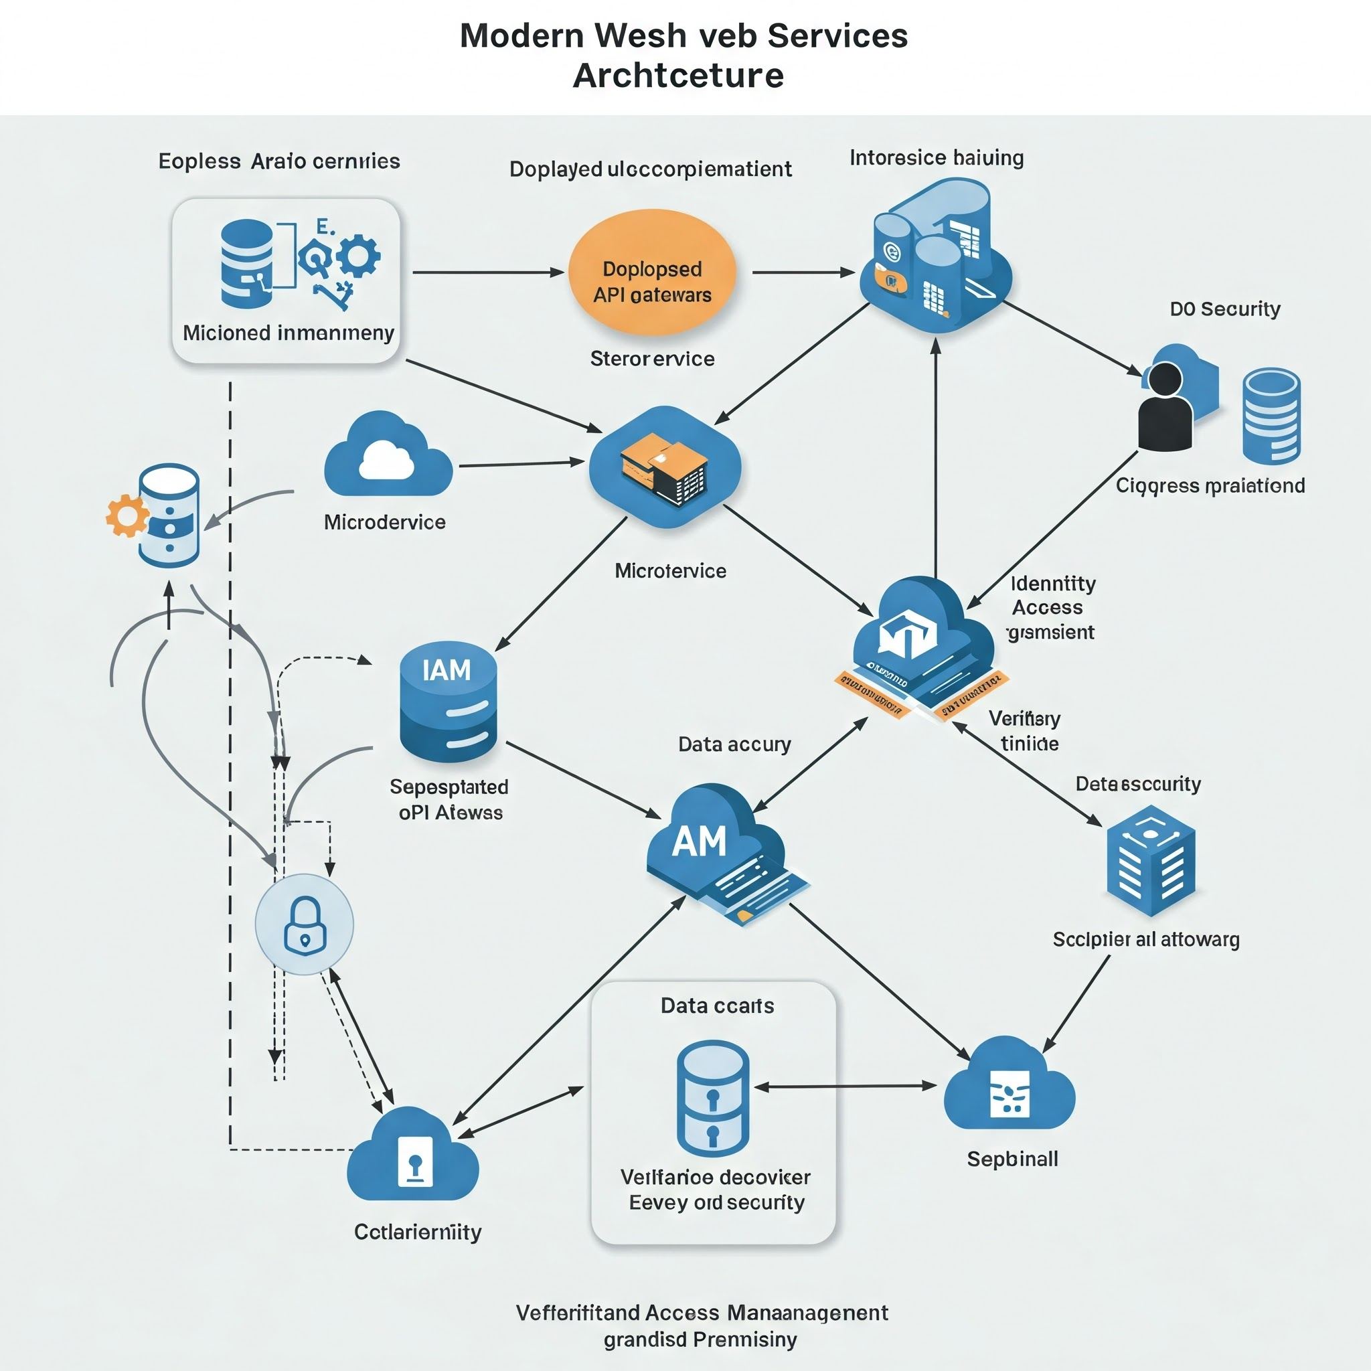
Services
Cloud Hosted Services
Cloud root accounts
DNS (godaddy, route53, cloudflare)
Email
Web Hosting
Wordpress, Drupal, Wix
CDN (content delivery Network)
Payment processing (stripe, square)
SSL certificates
Expiry dates sneak up
Financial (Intuit, banking, bill.com)
Janitorial
Notes:
While in modern computing the lines blur …
Software – things you install on your computer
Services – things you access via a webbrowser
What things are you gonna collect on each service:
Date acquired/purchased
Expiration date/renewal
Cost
SKU
Warranty information
Purchase order #
Who has possession
Latest software version

Slide 11
Asset Inventory Utility
Why is this valuable?
Understand new vulnerabilities
Plan updates
Bake in observability
Support incident response
Notes:
Threat surface / Attack surface – number of possible points of attack where an authorized access can happen

Slide 12
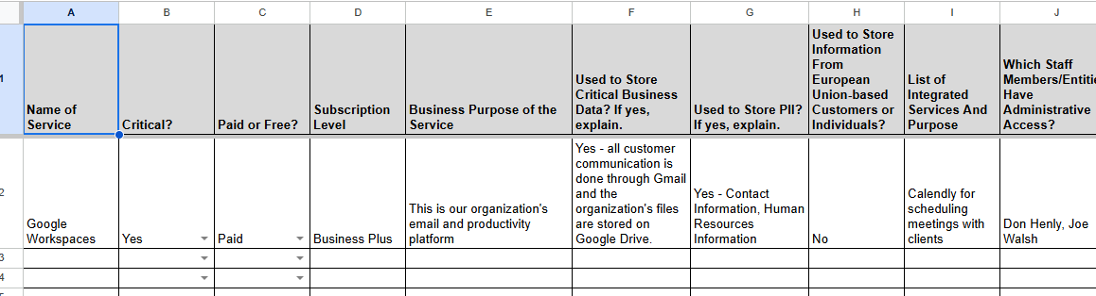
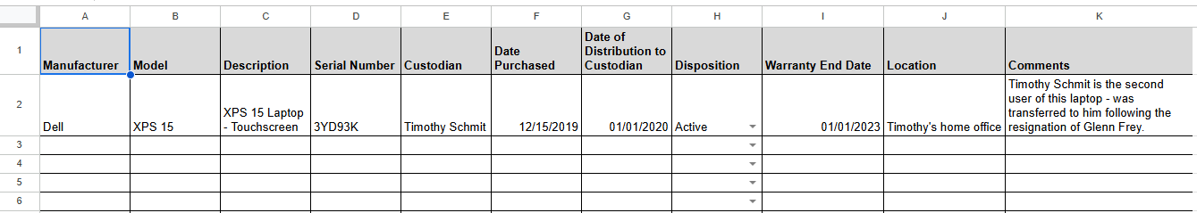
Live Demo
Google Sheets - IT Inventory Template from Rip Rap - Google Sheets
Notes:
Threat surface / Attack surface – number of possible points of attack where an authorized access can happen

Slide 13
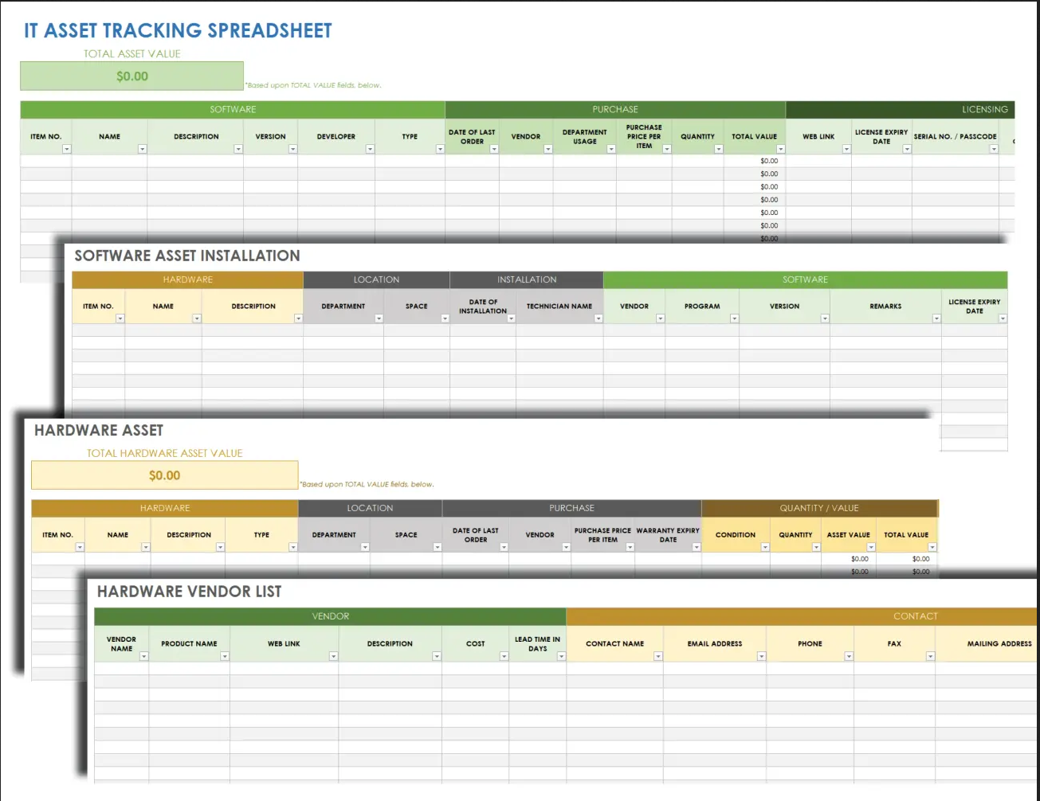
Live Demo
Snipe-IT live DEMO https://demo.snipeitapp.com/
Notes:
Threat surface / Attack surface – number of possible points of attack where an authorized access can happen

Slide 14
Asset Inventory Review
2. Gather Asset Inventory Information
2
1. Decide on Asset Inventory Tool.
1
3
3 . Keep Asset Inventory Tool up to date with current assets
4. Use Asset Inventory Tool to make decisions
4
Notes:
End goal have funders for area introduce NGO ISAC to grantees with benefits of collaboration clear
THANK THE AUDIENCE FOR ENABLING THIS TRANSFORMATION

Slide 15
Thank You
https://www.ngoisac.org/
membership@ngoisac.org

